Slide 1

System Administration
Abdul-Lateef Yussiff
Department of Computer Science & Information Technology
University of Cape Coast
Essentials Commands & File Hierarchy System

Slide 2
The Philosophy of Digging
There’s an adage about the two types of sysadmins:
A wizard is someone who knows how to do everything, and
a guru is someone who knows how to find the answer to everything.
Which do you think is a better model for you?

Slide 3
Chapter Goal
Objective is to test students’ understanding of the basic Unix command.
Syntax of Unix Command.
To introduce students to the Concept of Unix File Hierarchy and organization

Slide 4
Common Scenario
You’ve been working with Ubuntu Linux on your home computer to learn the Unix operating system, and your boss asks you to start maintaining a Red Hat Linux box. So far, so good. Three weeks later, a new Chief Technology Officer is hired and she announces, “All servers will be replaced with Sun Solaris systems forthwith!” Now you’re going to move into a completely new Unix environment.

Slide 5
Pre-Lesson Test
What UNIX commands would you use to
change to your home directory
display the list of files in the current directory
display my name is Abdul-Lateef onto the screen
copy the file tmp.dat from the current directory to the directory data underneath your home directory and after the file has been copied delete it
What will the following UNIX commands do? Don't execute a UNIX command if you aren't sure what it is going to do. In particular do not try to execute the first command below.
rmdir ~
cat /etc/passwd
ls ../../fred/doc/tmp

Slide 6
A command for everything
A fairly intelligent and experienced would be computer professional has just started using UNIX seriously (he was a student in Mr Obuobi’s course). He gets to a stage where he wants to change the name of some files.
Being an MS-DOS junkie from way back what command does he look for? The rename command of course. It doesn't work! "That's a bit silly!", he thinks, "You would think that UNIX would have a rename command."

Slide 7
Unix File System
Files are central to Unix in ways that are not true for some other operating systems.
Commands are executable files, usually stored in standard locations in the directory tree.
System privileges and permissions are controlled in large part via access to files. Device I/O and file I/O are distinguished only at the lowest level.
Unix view of files and its standard directory structure are among the first things a new administrator needs to know about.

Slide 8
Philosophy of Unix Commands
There are no set of rules about UNIX commands however there is a UNIX philosophy that is used by many of the commands.
Small is beautiful, UNIX provides the mechanisms to join commands together so commands should do one thing well.
10 percent of the work solves 90 percent of the problems, UNIX was never designed to solve all problems, it was designed to solve most requirements without too much hassle on the programmer's part.
Solve the problem, not the machine, Commands should ignore any machine specific information and be portable.
Solve at the right level, and you will only have to do it once. The key to UNIX problem solving is only to do it once e.g. pattern matching is only implemented once, in the shell, not in every command

Slide 9
Syntax of Unix Command
command_name -switches parameter_list
Component | Explanation
command_name | the name of the actual command, generally this is the name of the executable program.
-switches | The - symbol is used to indicate a switch. A switch modifies the operation of a command.
parameter_list | the list of parameters (or arguments) that the command will operate on, could be 0, 1 or more parameters, parameters are separated by white space characters (space, TAB)

Slide 10
Example commands
ls -l The switch -l is used to modify the action of the ls command so that it displays a long listing of each file.
ls -l /etc/passwd / /var Commands can take multiple parameters.
ls -ld /etc/passwd / /var Multiple switches can also be used.

Slide 11
Example of Unix Command
Command | Purpose | Command | Purpose
date | Display the current time and date | who | Display a list of people who are logged on currently on the computer
banner | Display a large banner | cal | display a calendar
whoami | Displays the current logged on username | cat | display the contents of a file
more and less | Display the contents of a file a page at a time | head | display the first few lines of a file
tail | Display the last few lines of a file | sort | sort the content of a file into order
uniq | Remove duplicate lines from a file | cut | remove columns of characters from a file
paste | join columns of files together | tr | translate specific characters
grep | Display all lines in a file containing a pattern | wc | count the number of characters, words and lines in a file

Slide 12
LAB – 1: Unix Command
Due Date:17th February, 2020

Slide 13
File Hierarchy
A Unix file system is a collection of files and directories that has the following properties −
It has a root directory (/) that contains other files and directories.
Each file or directory is uniquely identified by its name, the directory in which it resides, and a unique identifier, typically called an inode.
By convention, the root directory has an inode number of 2 and the lost+found directory has an inode number of 3. Inode numbers 0 and 1 are not used. File inode numbers can be seen by specifying the -i option to ls command.
It is self-contained. There are no dependencies between one filesystem and another.
The Filesystem Hierarchy Standard (FHS) defines the directory structure and directory contents in Unix distributions.

Slide 14
FHS Continued …
This standard consists of a set of requirements and guidelines for file and directory placement under UNIX-like operating systems.
The guidelines are intended to support interoperability of applications, system administration tools, development tools, and scripts as well as greater uniformity of documentation for these systems.
This standard enables:
Software to predict the location of installed files and directories, and
Users to predict the location of installed files and directories.

Slide 15
Purpose of FHS
It is possible to define two independent distinctions among files:
shareable vs. unshareable and variable vs. static. In general, files that differ in either of these respects should be located in different directories. This makes it easy to store files with different usage characteristics on different filesystems.
"Shareable" files are those that can be stored on one host and used on others.
"Unshareable" files are those that are not shareable. For example, the files in user home directories are shareable whereas device lock files are not.
"Static" files include binaries, libraries, documentation files and other files that do not change without system administrator intervention. "Variable" files are files that are not static.

Slide 16
Shareable and unshareable files
Shareable files can be stored on one host and used on several others. Typically, however, not all files in the filesystem hierarchy are shareable and so each system has local storage containing at least its unshareable files. It is convenient if all the files a system requires that are stored on a foreign host can be made available by mounting one or a few directories from the foreign host.
Static and variable files should be segregated because static files, unlike variable files, can be stored on read-only media and do not need to be backed up on the same schedule as variable files.

Slide 17
Unix File Hierarch System
/ (root)
|
---------------------
| | |
/bin /usr /tmp
|
|
------------------------------------------------------------
| | | |
/public /misc /staff /students
| | |
------------ ------------------- ----------------------
| | | | | | | | | |
/software /doc /john /mary /bill /carl /tom /dick /mary /lisa

Slide 18
File Hierarchy – Major Directories
Directory | Contains
bin/ | Required Boot-time binaries. Essential command binaries that need to be available in single user mode; for all users, e.g., cat, ls, cp.
boot/ | Boot configuration files for the OS loader and kernel image. Boot loader files, e.g., kernels, initrd.
dev/ | Device files. e.g., /dev/null, /dev/disk0, /dev/sda1, /dev/tty, /dev/random
etc/ | System configuration files and scripts
home/ | User/Sub branch directories. Users' home directories, containing saved files, personal settings, etc
lib/ | Main OS shared libraries and kernel modules. Essential for the binaries in /bin and /sbin.
Lost+found/ | Storage directory for "recovered" files
mnt/ | Temporary point to connect devices to . Temporarily mounted filesystems. .
proc/ | Pseudo directory structure containing information about the kernel, currently running processes and resource allocation.
root/ | Linux (non-standard) home directory for the root user. Alternate location being the / directory itself
sbin/ | System administration binaries and tools
tmp/ | Location of temporary files
usr/ | Difficult to define - it contains almost everything else including local binaries, libraries, applications and packages (including X Windows)
var/ | Variable data, usually machine specific. Includes spool directories for mail and news

Slide 19
The Root File system
The contents of the root file system must be adequate to boot, restore, recover, and/or repair the system.
To boot a system, enough software and data must be present on the root partition to mount other file systems. This includes utilities, configuration, boot loader information, and other essential start-up data. /usr, /opt, and /var are designed such that they may be located on other partitions or file systems.
To enable recovery and/or repair of a system, those utilities needed by an experienced maintainer to diagnose and reconstruct a damaged system must be present on the root file system.
To restore a system, those utilities needed to restore from system backups (on floppy, tape, etc.) must be present on the root file system.

Slide 20
The Root File system [2]
The minimum requirements for the root file system should be as small as reasonably possible. While many users may not want the extra complexity of a partitioned system, the option to keep the root small should be preserved for several reasons:
The root filesystem contains many system-specific configuration files. Possible examples include a kernel that is specific to the system, a specific hostname, etc. This means that the root file system isn't always shareable between networked systems. Keeping it small on servers in networked systems minimizes the amount of lost space for areas of unshareable files. It also allows workstations with smaller local hard drives.

Slide 21
The Root File system [3]
Disk errors that corrupt data on the root file system are a greater problem than errors on any other partition. A small root file system is less prone to corruption as the result of a system crash.
Reasons why creating a new subdirectory of the root file system is prohibited:
It demands space on a root partition which the system administrator may want kept small and simple for either performance or security reasons.

Slide 22
Bin Directory / Sub-Directory
bin is short for binary - binary or executable files
/bin
/sbin
/usr/bin
/usr/local/bin
Why so many bins?
Ease of backup
Administration
Logical separation
Notes:
None of which should be used for storing junk files.

Slide 23
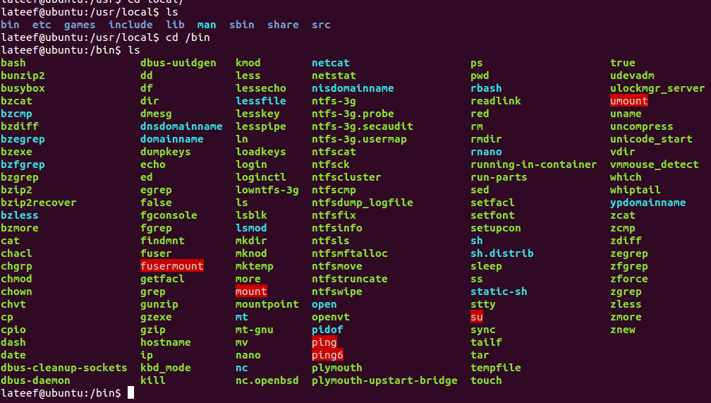
/bin
This directory must be present for the OS to boot. It contains utilities used during the startup; a typical listing would look something like shown in the right figure.
The /bin directory will contain as few files as possible as this makes it easier to take a direct copy for recovery boot/root disks.

Slide 24
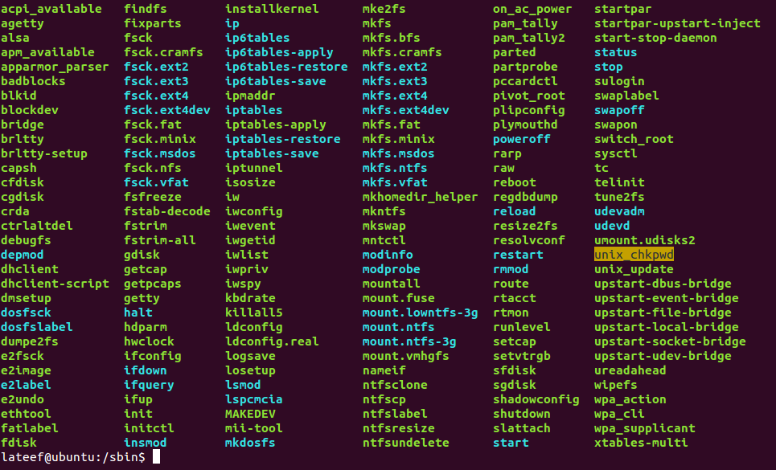
/sbin
/sbin Literally "System Binaries".
This directory contains files that should generally only be used by the root user, though the Linux file standard dictates that no access restrictions should be placed on normal users to these files.
it is (by default) not included in the PATH of normal users.
The /sbin directory should contain essential system administration scripts and programs

Slide 25
Sbin subdirectories continued …
You should also be aware of:
/usr/sbin - used for non-essential admin tools.
/usr/local/sbin - locally installed admin tools
This directory contains any non-essential binaries used exclusively by the system administrator. System administration programs that are required for system repair, system recovery, mounting /usr, or other essential functions must be placed in /sbin instead.

Slide 26
/usr/bin & /usr/local/bin
This directory contains most of the user binaries - in other words, programs that users will run. It includes standard user applications including editors and email clients as well as compilers, games and various network applications
Softwares that are installed by the system administrator after OS has been installed should be placed in /usr/local/bin. The main reason for doing this is to make it easier to back up installed programs during a system upgrade, or in the worst case, to restore a system after a crash.
The /usr/local/bin directory should only contain binaries and scripts
it should not contain subdirectories or configuration files.

Slide 27
Configuration files, logs and other bits!
/etc is one place where the root user will spend a lot of time. It is not only the home to the all important passwd file, but contains just about every configuration file for a system (including those for networking, X Windows and the file system)
The /etc hierarchy contains configuration files. A "configuration file" is a local file used to control the operation of a program; it must be static and cannot be an executable binary.
The /etc branch also contains the skel, X11 and rc.d directories
/etc/skel contains the skeleton user files that are placed in a user's directory when their account is created
/etc/X11 contains configuration files for X Windows

Slide 28
Configuration files, logs and other bits! Continues …
/etc/rc.d is contains rc directories - each directory is given by the name rcn.d (n is the run level) - each directory may contain multiple files that will be executed at the particular run level. A sample listing of a /etc/rc.d directory looks something like
Logs
Linux maintains a particular area in which to place logs (or files which contain records of events). This directory is /var/log
/proc
The /proc directory hierarchy contains files associated with the executing kernel. The files contained in this structure contain information about the state of the system's resource usage (how much memory, swap space and CPU is being used), information about each process and various other useful pieces of information.
The /proc file system is the main source of information for a program called top. This is a very useful administration tool as it displays a "live" readout of the CPU and memory resources being used by each process on the system.

Slide 29
/dev & /VAR
This directory is the primary location for special files called device files.
/VAR
/var contains variable data files. This includes spool directories and files, administrative and logging data, and transient and temporary files.

Slide 30
Summary
Basic Unix Command
Unix File Hierarchy
/bin & /sbin
/dev

Slide 31
Exercises
You have just discovered that the previous system administrator of the system you now manage installed netscap in /sbin. Is this an appropriate location? Why/Why not?.
Where are man pages kept? Explain the format of the man page directories
As a system administrator, you are going to install the following programs, in each case, state the likely location of each package:
Java compiler and libraries
DOOM (a loud, violent but extremely entertaining game)
A network sniffer (for use by the sys admin only)
A new kernel source
An X Windows manager binary specially optimised for your new monitor

